Slide 1
Advanced Database Systems
Winter Semester
Week 1- Part One (Project Discussion)
Ahmad

Slide 2
Project
The project forms 40% of your final marks.
In this project you need to create a survey on a recent topic in Databases
The project has two components:
  A Presentation (15% of your mark)
  A Report (25% of your mark)
The aim of the project is to help you learn writing a survey.
Surveys are created to keep the researchers updated with the recent development of technology.

Slide 3
Project Groups- 1
Project is done in group of 4 students.
You are responsible for forming groups and finding your group members.
  This is an intensive semester of only 4 teaching weeks, so you need to form a group by the end of week 1.
  You can do this in this tutorial or through the Ed discussion in Canvas.
  Students from different tutorials can be in the same group.
  You need to create a group with your group members in the People section of Canvas. Check the link below on how to create a group:
    https://community.canvaslms.com/docs/DOC-10516-421264913

Slide 4
Project Groups- 2, Project Topics
Choose a topic as a team from the list below:
  Crowdsourced and Collaborative Data Management (In a nutshell: Databases where many people contribute to the data and workings of the system)
  Self-driving Databases (In a nutshell: Databases that take over functions from the Database administrators such as tuning, index selection, improve performance, etc.)
You need to submit you group information by end of week 1 (July 2, 2023 11:59pm).
    You can submit in Canvas->Assignments->A. Group topic submission.
    Only one member needs to submit the group information. Group information has:
      Group ID (This is assigned to you after joining a group in People section of Canvas)
      Name and Student ID of the group members.
      Topic of the project. If the topic changes, you may resubmit, no later than the deadline.

Slide 5
Project Groups- 3, Getting into the Business
Start Familiarizing yourself with the literature. You can begin with less formal articles Wikipedia, newspaper/magazine, and similar articles/webpages to get a high-level idea about your chosen topic.
After this initial phase, you should use scholar.google.com or similar scholarly search engines for performing a more detailed background search and do further reading. At the end of this phase, you should know important keywords by which you can do a more focused search.
You can also explore the list of accepted papers of the top venues (listed below) for finding related papers.
  Top Venues: SIGMOD, VLDB, ICDE, SIGKDD, SIGIR, SIGSPATIAL, ICDM, TKDE, VLDBJ, ACM TODS
  For finding this list, search for “Venue name + accepted papers + year”
  For finding the list of the accepted papers of a journal, go to journal page.

Slide 6
Project Groups 4- Group Dynamics
The main concept in group dynamics is fairness. You should be able to evenly distribute the work among team members.
This semester is a short semester. So you need to be in contact with your team members constantly, plan and act.
Pick a communication channel (like Microsoft Teams), set a group leader for each week, set milestones for each week, assign measurable tasks to each member and review your progress at the end of each week.
Group reflection and Individual reflection in the report:
  It is also important how you do your project, and what is the contribution of each member. This should be reported in your final report submission.
    In a page you should explain how you found and chose your references and other learnings.
    Each student should explain in 200 words what was their contribution (marked independently).

Slide 7
Time to Find your Team-mates
We allocate 10 minutes of this tutorial to group formation.
If you have not teamed-up before, use this time to approach other students and form groups.
If you found your team-mates (or already have), please claim a breakout room (please post in the chat the breakout room number), and then everyone from your team can join the breakout room.
Then you can use this time to talk about your topic, and join a group in Canvas.
The project spec file from Canvas can help you a lot.

Slide 8
How to choose the right papers?
Start with an initial set of keywords.
Surveys can help a lot in understanding the topic, but do not use them as your main source. They can also stand as a good example.
Search scholar, or the list of accepted papers to find titles that include your keywords.
Read abstract and judge whether it is suitable to your topic.
Ideally, you should read around 60 abstracts, skim around 35 of them and read and report around 20 of them. Only list the top papers.
Use the authors as a way of finding your papers.

Slide 9
Report Rationale
It is important that the report is not only about listing the top papers, but you should be able to categorise the developments/ approaches and compare and critique them.
  Comparison, and critical analysis is at the core of the survey.
  You are not expected to learn every paper in detail perfectly comprehensive about the topic.
    Instead, you should cover key directions/ideas and be able to classify them.
The sections of your presentation/report should show that you know the categorization of works in your topic of choice.

Slide 10
Report Structure
Identification info for students/title/abstract/etc (1 cover page)
Introduction to the Topic Area (1 page)
Related Work Details (papers covered explained in brief in some structured manner, categorisation, how a paper extended an approach from a previous paper, etc.) (6 pages)
Comparison of Key Approaches/Papers (benefits and disadvantages from various aspects, when some approach is more applicable than other, etc.) (2 pages) [Note: This part can be presented combinedly with related work]
- Conclusions/Discussions and Future Directions (1.5 pages)
- Group reflection (0.5 page) [details below]
- Individual reflection (maximum 200 words per student in the group) [details below]
- References (1 page)

Slide 11
Presentation Rationale and Structure
Presentation is done as a team via zoom.
You do not need to include group and individual reflections into the presentation.
You will have no more than 25 mins to complete your presentation.
Better to follow the report structure in the presentation as well.
We recommend 14-18 slides for the presentation.
The presentation file needs to be submitted to Canvas->Assignment->B before your presentation.

Slide 12
Presentations: Three Most Important Things
Organization
Visual Aids
Delivery and Style

Slide 13
Be clear on: the Purpose & your Audience
Be clear about purpose of your talk
  What do you want your audience to learn?
Audience analysis
  Identify your audience and their understanding of the area
Notes:
The message should be there.

Slide 14
Introduction
Earn the audience’s attention
Roadmap
  Explain where you plan to go, set up the story
  Create a table or figure to organize the area
“Don’ts”
  Apologize for being nervous
  Read the introduction or in general any slide
Remember: Keep it very simple for the introduction
  No excessive use of technical abbreviations etc
Notes:
Note: The time allotted to you is comparable to a standard conference presentation so 30 mins is alot

Slide 15
Body of Your Presentation
Create main points, do not form full sentences
Presentation & Language
  Present points as declarative statements
  Keep speech points unified, coherent, and balanced
  Verbalize connections between points
  Do not form full sentences or paragraphs
  Do not spend time on code or formulas unless it is a must, and even then only a few lines at a time in a slide
  Any symbols used must be defined and do not use more than a few in any single slide if possible

Slide 16
Some Formatting Issues: Fonts Are Important
Use sans serif fonts
Use readable font sizes
Use appropriate color combinations
40 point Title
28 point Heading/Body
24-20 point Sub-headings
Anything smaller is too small

Slide 17
How about this colorful slide?
Use sans serif fonts
Use readable font sizes
Use appropriate color combinations

Slide 18
Visual Aids Do’s and Don’ts
Do’s
Design them large enough
Design them to be simple
Design them to be clear
Label them
Use only what you need
Don’ts
Use too much text
Use excessive artwork
Make things look cramped
Use too many colors
Overuse capital letters

Slide 19
Transitions
A word or phrase that signals when a speaker is moving from a topic or handing over to the next presenter
Two parts to a transition
  Idea that the speaker is leaving [the review part]
  Idea that the speaker is coming up to [the preview part]
Example
  Now that you have seen a general overview of XYZ [review], I will discuss each of them in turn [preview]
Use a map to remind people which part of a presentation or area in a survey you are coming from and going to…
This is critical for team presentations

Slide 20
Discussion/Conclusion Part
Purpose: Tell them what you told them
  Use a slide or two for comparing approaches
    Use figures, tables, charts
  Offers the audience a sense of closure
Further Tips
  Signal the end verbally and non-verbally if you can
  Make conclusions strong and brief
Don’ts
  Drag out the conclusion
  End on a weak or rambling note
  Introduce new points that were not mentioned before

Slide 21
Some Side Tips
Use of capital letters/special fonts: Many people use too much of these:
  Bullet points typically have one capital letter at the beginning
  Just because You think a Word is Important does NOT mean you should Emphasize things all the time as it becomes hard to read!
  ALL CAPITAL LETTERS MAKES IT HARD FOR YOUR AUDIENCE TO READ AS WELL!
  Exclamations: Don’t use it too much as well!!!!!!!!!!!!!!!

Slide 22
Practicing
It is the most important aspect of a presentation
Very critical for team presentations
You will find out if you
  Make sense and sound knowledgeable
How to practice
  Highlight in your notes difficult pronunciations
  Practice in a setting similar to how you will present
  Imagine the audience to whom you will present
  Always practice out loud and as a team as well

Slide 23
Last But Not Least: Establishing Credibility
  Make sure you know your work
  Nothing replaces knowledge, no fonts, no colors, etc
  Speak loud and confident enough
  Look at the audience
  Don’t assume your audience knows though
    Watch for audience’s non-verbal feedback
    Adjust your rate, content, or eye contact for them

Slide 24
After the Presentation: Handling Questions and Answers
Decide who will answer which types of questions and when
Use welcoming body language
Reword the question before answering for all to hear if need be
Say “I don’t know” if you do not know

Slide 25
Some Further Teamwork Considerations
Work out all transitions clearly
  Between sections
  Between team members
  Try to map between these carefully
Practice as a team multiple times and more than you would do otherwise
Speak with one at a time
Give the speaking member full attention yourself as well
  If you look distracted it will make your audience distracted

Slide 26
Reports
A good presentation design → A good report
  Even if you do not perform well in a presentation, the preparation helps with the report
Structure is pretty much the same for the presentations as well as the report
Figures should be reused so they are not wasted
Audience considerations directly translate
Many issues such as Introduction being simple directly applies

Slide 27
Format/Structure of a Report
Please do not deviate from what the Project Specs say
These are given with a proper real-life report in mind

Slide 28
Details on Related Work/Analysis
Background and critical analysis:
  Background cannot be a simple list of papers
    This is the most important issue with bad surveys
  Organize into subcategories/sections
  There is always a higher learning level you can give to the audience/readers (same with the presentations)
  Figure out parameters that matter for comparison
  Create a table of comparison (or two)

Slide 29
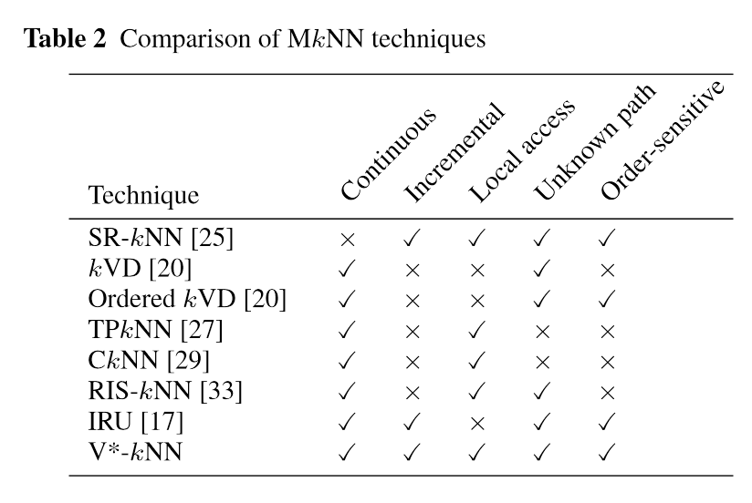
An Example Comparison Table

Slide 30
Wrapping It Up
Conclusions and future directions
  Do not underestimate yourself, be innovative
  Do not repeat the Introduction
References and sources
  You should cite extensively for a survey but exclude papers with incremental contributions
    Use: citation counts, source of the paper, author reputations, etc.
    Do not cite papers that you have not read for the survey
  Citations should be done professionally
    Follow ACM Computing Survey style for the formatting for example

Slide 31
Take a Break (10 Minutes)
Take a break for 10 minutes.
Deep breath and some stretches would help.

Slide 32
Advanced Database Systems
Winter Semester
Week 1- Part Two (HDD/ SSD/ Memory Hierarchy)
Ahmad

Slide 33
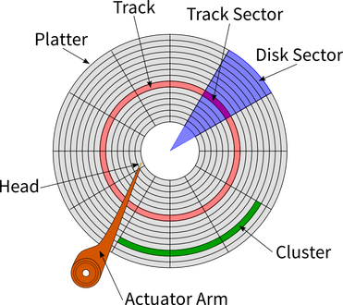
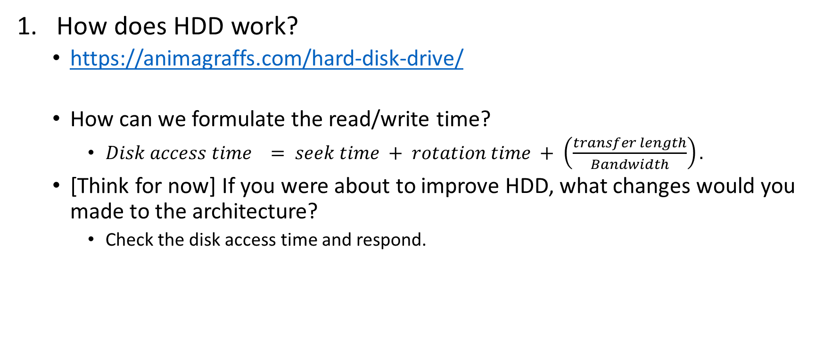
Hard Disk Drives (HDD)
How does HDD work?
  https://animagraffs.com/hard-disk-drive/
  How can we formulate the read/write time?
    $Disk access time = seek time + rotation time + \left(\frac{transfer length}{Bandwidth}\right).$
  [Think for now] If you were about to improve HDD, what changes would you made to the architecture?
    Check the disk access time and respond.
Notes:
circular rotating platter, which are divided into circular tracks, tracks are further divided into tract sectors. An actuator arm with magnetic head can move over the tracks to read the data.

Slide 34
Question 1 (Breakout rooms)
In a hard disk drive (HDD), the average seek time is 12 ms, rotation delay is 4 ms, and transfer rate is 4MB/sec. For simplicity we assume 1MB equals to 1000KB.
  What physical property of an HDD causes the seek time delay?
  What physical property of an HDD causes the rotation delay?
  What will be the disk access time for a transfer size of 8MB? What will be the disk access time for a transfer size of 8KB?
  In a solid state drive, what will be the disk access time for a transfer size of 8MB when transfer rate 4MB/sec? Is an SSD faster than an HDD for the same amount of data transfer (Assuming the base sequential data transfer rates are the same for the given two drives.)? Why?

Slide 35
Question 1- Solution (1)
What physical property of an HDD causes the seek time delay?
  The seek time delay/seek latency is the period that the head of the actuator arm moves from a position to a required track.
What physical property of an HDD causes the rotation delay?
  The rotation delay/rotation latency is the waiting period that the rotation of the disk brings the required sector of a track to head of the actuator arm.
What will be the disk access time for a transfer size of 8MB? What will be the disk access time for a transfer size of 8KB?

Slide 36
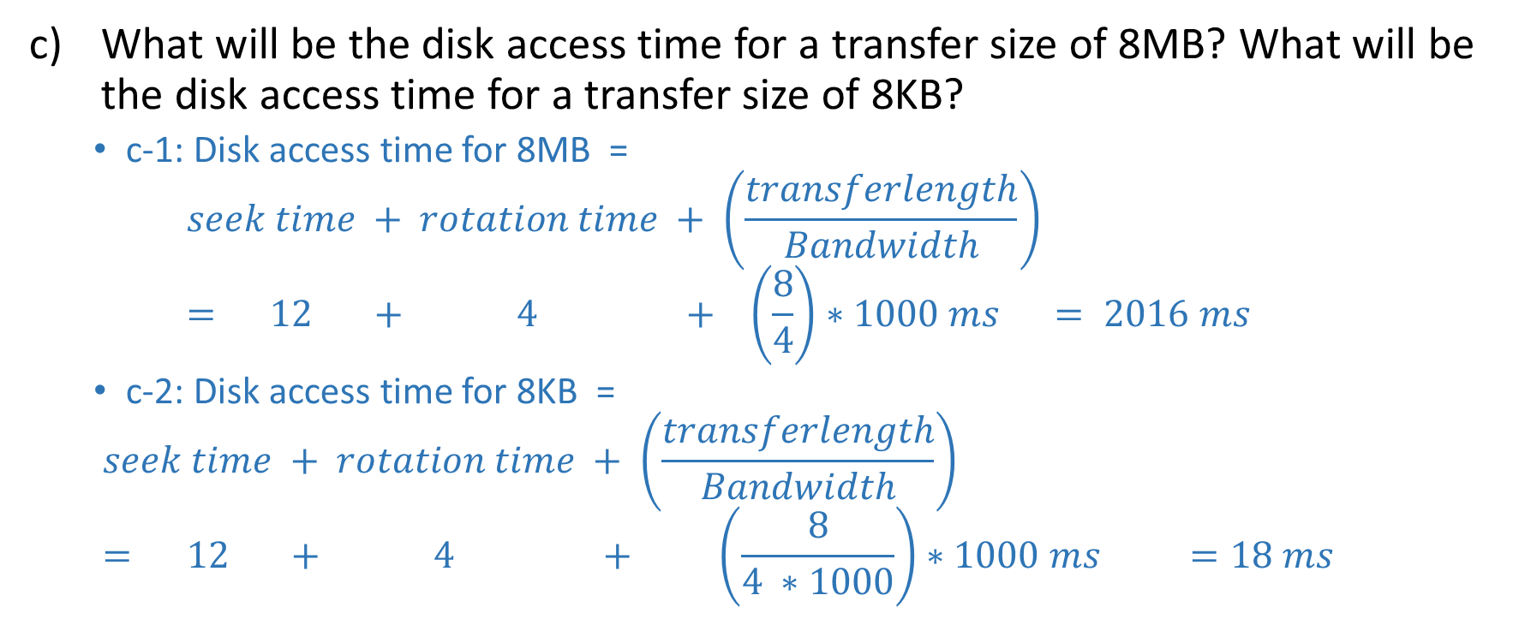
Question 1- Solution (2)
What will be the disk access time for a transfer size of 8MB? What will be the disk access time for a transfer size of 8KB?
  c-1: Disk access time for 8MB =
  $$seek time + rotation time + \left(\frac{transferlength}{Bandwidth}\right)= 12 + 4 + \left(\frac{8}{4}\right)∗1000 ms = 2016 ms$$
  c-2: Disk access time for 8KB =
  $$seek time + rotation time + \left(\frac{transferlength}{Bandwidth}\right)= 12 + 4 + \left(\frac{8}{4 ∗1000}\right)∗1000 ms =18 ms$$

Slide 37
Question 1- Solution (2)
What will be the disk access time for a transfer size of 8MB? What will be the disk access time for a transfer size of 8KB?
  A comparison of the two cases highlights that sequentially reading large data pays off as seek time is buried under a lot of transfer time. For example, in the first case, seek time is only 0.6% of the total time while nearly all the time is spent on transferring data. In the second case, seek time is 66.7% of the total time while only a small fraction of the time is spent on data transfer.

Slide 38
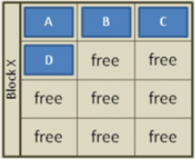
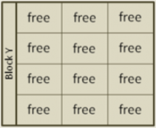
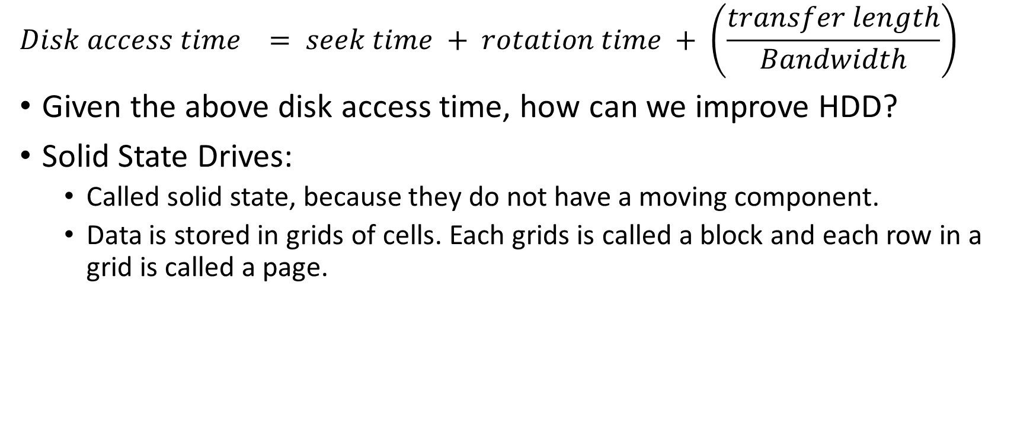
Improvement over HDD with SSD
$$Disk access time = seek time + rotation time + \left(\frac{transfer length}{Bandwidth}\right)$$
Given the above disk access time, how can we improve HDD?
Solid State Drives:
  Called solid state, because they do not have a moving component.
  Data is stored in grids of cells. Each grids is called a block and each row in a grid is called a page.
Notes:
Get rid of the seek time and rotation time, improve bandwidth.

Slide 39
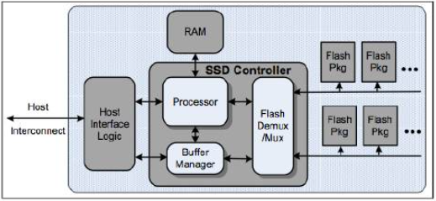
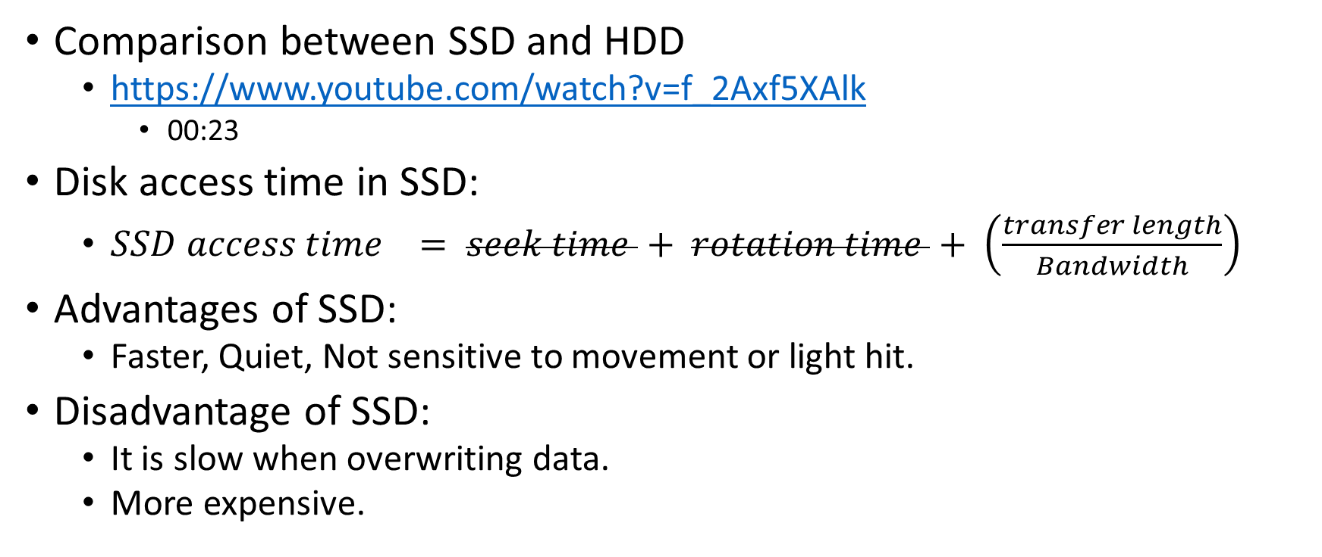
SSD (2)
Comparison between SSD and HDD
  https://www.youtube.com/watch?v=f_2Axf5XAlk
    00:23
Disk access time in SSD:
  $SSD access time = seek time + rotation time + \left(\frac{transfer length}{Bandwidth}\right)$
Advantages of SSD:
  Faster, Quiet, Not sensitive to movement or light hit.
Disadvantage of SSD:
  It is slow when overwriting data.
  More expensive.

Slide 40
Back to Question 1 (Breakout rooms)
d) In a solid state drive, what will be the disk access time for a transfer size of 8MB when transfer rate 4MB/sec? Is an SSD faster than an HDD for the same amount of data transfer? Why?
Notes:
Unlike an HDD, an SSD do not have any rotating part. Hence there is no rotation delay or seek delay in and SSD. Therefore, for the same transfer rate and same amount of data transfer, an SSD is always faster than an HDD. Moreover, the data transfer rate of SSDs is usually higher than that of HDDs in general as well.
Disk access time of SSD = (transfer length/Bandwidth)= (8/4) sec = 2 sec

Slide 41
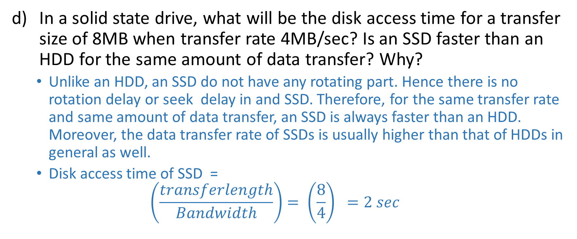
Question 1- Solution (2)
In a solid state drive, what will be the disk access time for a transfer size of 8MB when transfer rate 4MB/sec? Is an SSD faster than an HDD for the same amount of data transfer? Why?
  Unlike an HDD, an SSD do not have any rotating part. Hence there is no rotation delay or seek delay in and SSD. Therefore, for the same transfer rate and same amount of data transfer, an SSD is always faster than an HDD. Moreover, the data transfer rate of SSDs is usually higher than that of HDDs in general as well.
  Disk access time of SSD =
  $$\left(\frac{transferlength}{Bandwidth}\right)= \left(\frac{8}{4}\right) =2 sec$$

Slide 42
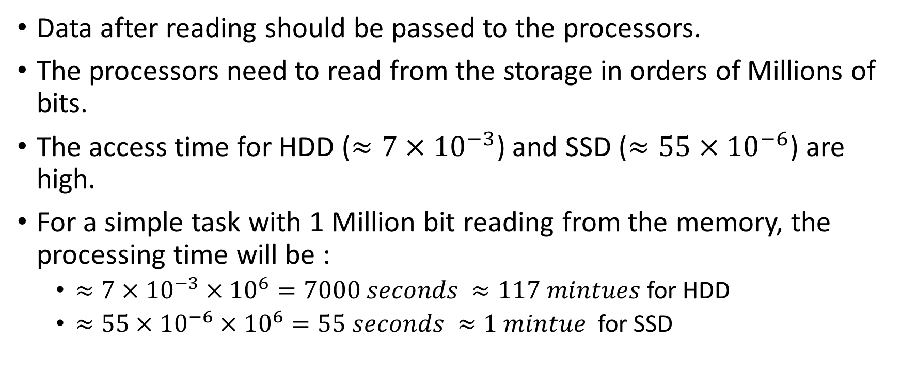
Where does the Data Drives Fit in Computers?
Data after reading should be passed to the processors.
The processors need to read from the storage in orders of Millions of bits.
The access time for HDD ($≈7×{10}^{−3}$) and SSD ($≈55×{10}^{−6}$) are high.
For a simple task with 1 Million bit reading from the memory, the processing time will be :
  $≈7×{10}^{−3}×{10}^{6}=7000 seconds ≈117 mintues$ for HDD
  $≈55×{10}^{−6}×{10}^{6}=55 seconds ≈1 mintue$ for SSD
Notes:
Suppose that a simple taks takes about 1 minute for the computer to do, doing demanding computation such as high graphic games will take forever to load.

Slide 43
How to solve the performance issue?
Any ideas?

Slide 44
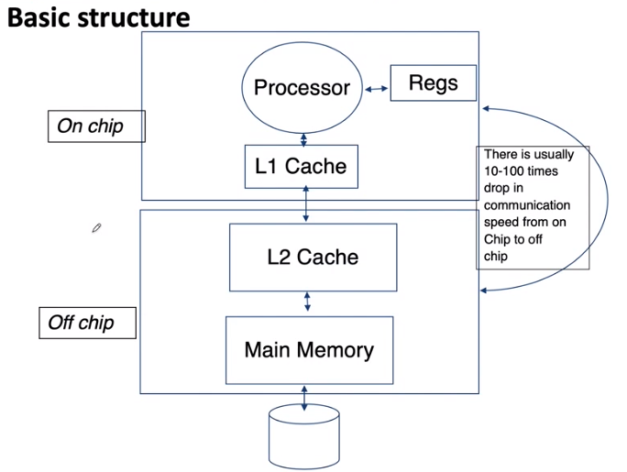
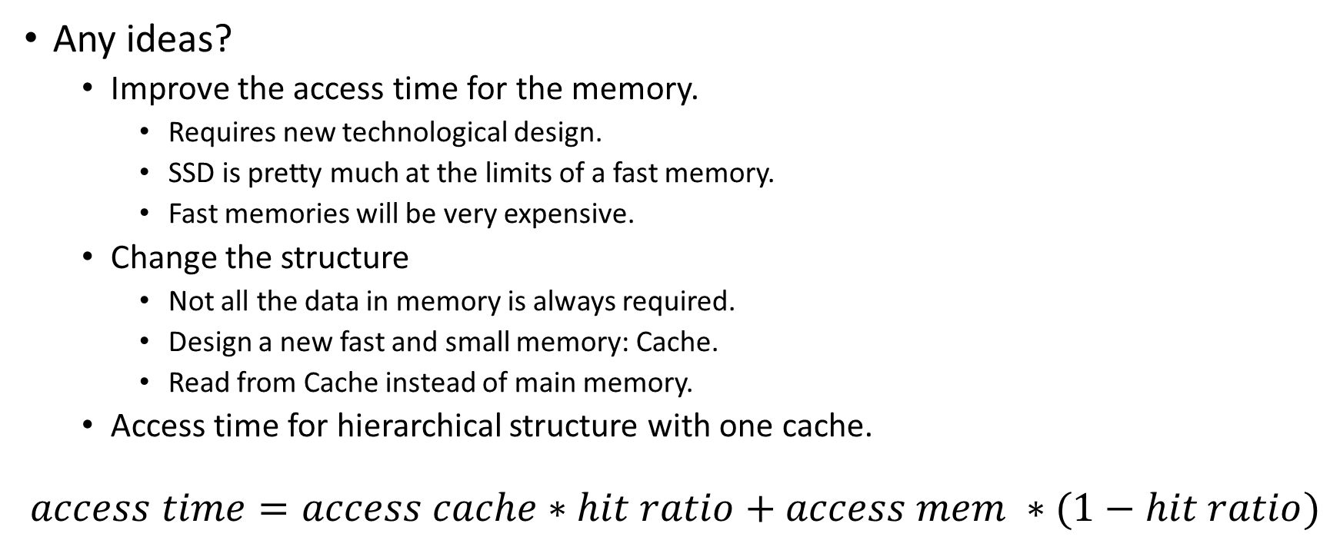
How to solve the performance issue?
Any ideas?
  Improve the access time for the memory.
    Requires new technological design.
    SSD is pretty much at the limits of a fast memory.
    Fast memories will be very expensive.
  Change the structure
    Not all the data in memory is always required.
    Design a new fast and small memory: Cache.
    Read from Cache instead of main memory.
  Access time for hierarchical structure with one cache.
$$access time=access cache∗hit ratio+access mem ∗(1−hit ratio)$$
Notes:
Can you extend it to multi-level cache?

Slide 45
Question 2 (Breakout Rooms)
There are two different machines where machine A has a smaller cache with on average 50% cache hit ratio (H) and the other machine (machine B) has a much larger cache with on average 90% cache hit ratio. However, the memory access time of machine A is 100C and the memory access time of machine B is 400C (i.e., memory access in machine A is faster than memory access in machine B), where C is the cache access time. Which machine has overall faster effective memory access time?
Notes:
Effective memory access time of A = 0.5*C + (1-0.5)*100C = 50.5C
Effective memory access time of B = 0.9*C +(1-0.9)*400C = 40.9C
Although memory access in machine A is faster than memory access in machine B, machine B has overall faster effective memory access time than machine A due to B’s larger cache with higher cache hit ratio.

Slide 46
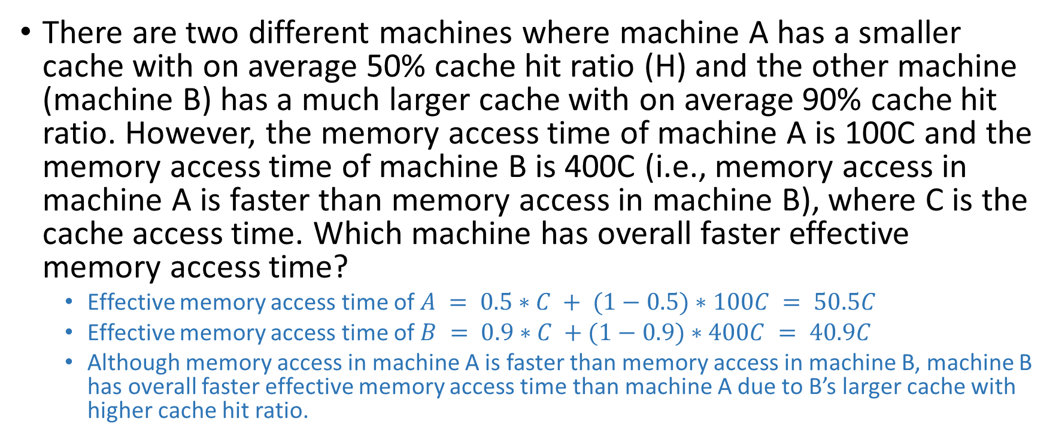
Question 2 (Answer)
There are two different machines where machine A has a smaller cache with on average 50% cache hit ratio (H) and the other machine (machine B) has a much larger cache with on average 90% cache hit ratio. However, the memory access time of machine A is 100C and the memory access time of machine B is 400C (i.e., memory access in machine A is faster than memory access in machine B), where C is the cache access time. Which machine has overall faster effective memory access time?
  Effective memory access time of $A = 0.5∗C + (1−0.5)∗100C = 50.5C$
  Effective memory access time of $B = 0.9∗C +(1−0.9)∗400C = 40.9C$
  Although memory access in machine A is faster than memory access in machine B, machine B has overall faster effective memory access time than machine A due to B’s larger cache with higher cache hit ratio.

Slide 47
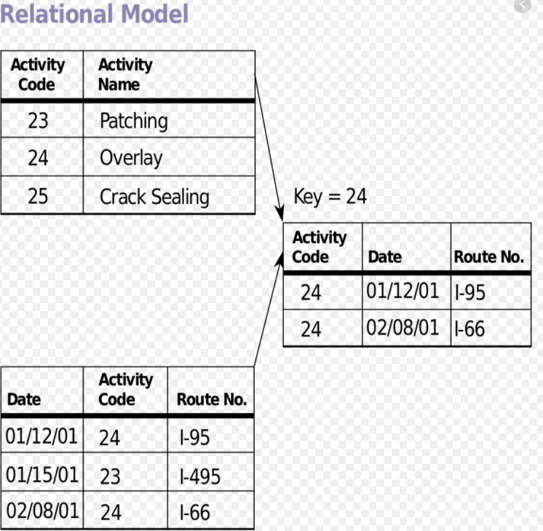
About different forms of Databases
Relational Databases
  Tables are structured related to each other
  Tables in database are related using
  primary/foreign key relationship.

Slide 48
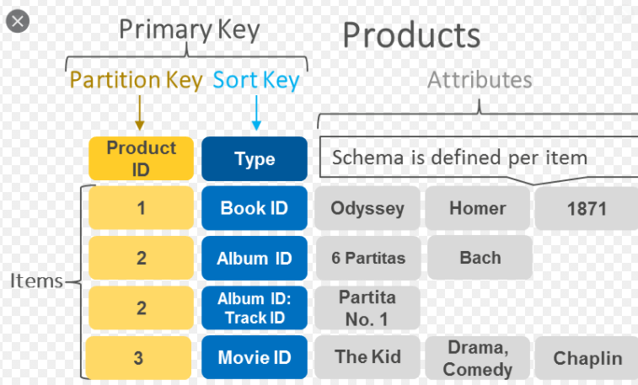
Key-Value Databases
2. Key-value storage: A key-value database stores data as a collection of key-value pairs where a key serves as a unique identifier. All access to the database are done via the key. Both keys and values can be complex.

Slide 49
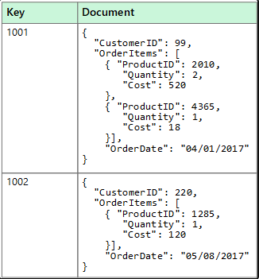
Document Storage
3. Document storage: Flexible for storing different kinds of documents, where they may not all have the same sections. XML, JSON, etc. are subclasses of document-oriented databases.

Slide 50
Graph Storage
Graphs capture connectivity between entities. Searching and traversing by relations are very fast in such structures.
  The links can be material or immaterial:
  Links between two streets are junctions;
  Links between people as their facebook connections (non material links)
  A graph is a structure amounting to a set of objects (called vertices) where some pairs of the objects are connected/related in some sense. A connection is called an edge.

Slide 51
Applications of different forms of Databases
Can you name applications of different forms of databases?
Notes:
For example,
Applications for key-value databases – Suitable if the dataset do not need complex relational table type of structure, but can be expressed with simple key-value pairs. The simple structure allows faster insertion and search, and scales quickly. For example – shopping cart in an e-commerce site.
Applications for document storages – Well suited when different kinds of documents do not always have the same structure/sections. For example – news articles.
Applications for graph databases – well suited for connection data: social network connection information, spatial data.

Slide 52
Applications of different forms of Databases
Applications for key-value databases – Suitable if the dataset do not need complex relational table type of structure, but can be expressed with simple key-value pairs. The simple structure allows faster insertion and search, and scales quickly. For example – shopping cart in an e-commerce site.
Applications for document storages – Well suited when different kinds of documents do not always have the same structure/sections. For example – news articles.
Applications for graph databases – well suited for connection data: social network connections (e.g., who are my friends of friends) , spatial data (e.g., route planning – which ways can I go now to reach destination).

Slide 53
Take a Break (10 Minutes)
Take a break for 10 minutes.
Deep breath and some stretches would help.

Slide 54
Advanced Database Systems
Winter Semester
Week 1- Part Three (Database Architectures/ Cloud Databases)
Ahmad

Slide 55
More on the Cloud DBS and Cloud Services
The life for developers and programs has become much easier by cloud computing services.
Cloud service providers have taken the responsibilities to do the dirty work, and provide an easy to use service to programmers.
Programmers no longer need to worry about the maintenance issues, or about the required hardware capabilities.
There are a number of cloud-service providers, and Amazon is one of the leading brands.

Slide 56
Amazon services
Amazon offers a number of different services including:
  virtual computers, block storage, simple storage, and Relational database
  In addition to these services, amazon also offers NoSQL database services (Amazon DynamoDB)
Here we review some of the most important Amazon cloud-services

Slide 57
Amazon Elastic Compute Cloud (EC2)

Slide 58
Amazon Storage Services
Amazon Elastic Block Storage
Amazon Simple Storage
The difference between elastic block storage (EBS) and simple storage service (S3) is EBS is only accessible from a single EC2 instance, while you can use S3 across multiple instances.

Slide 59
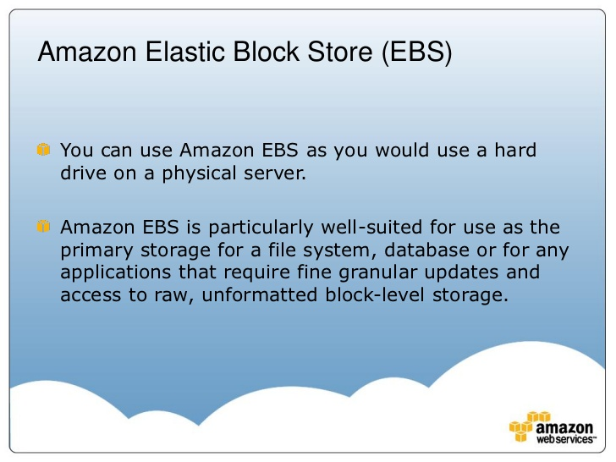
Amazon Elastic Block Storage

Slide 60
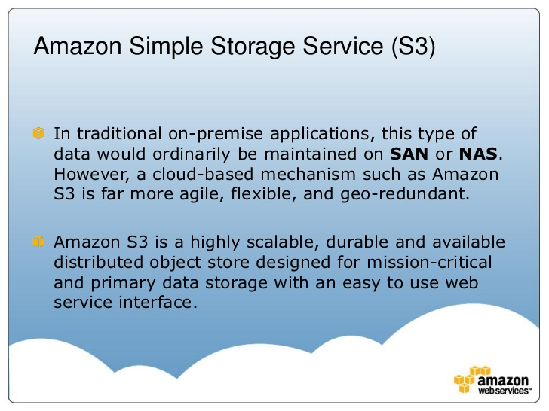
Amazon Simple Storage

Slide 61
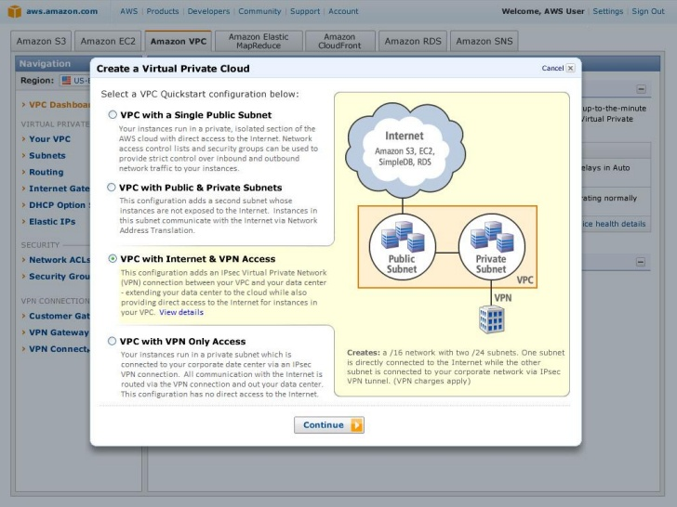
Creating Virtual Private Cloud

Slide 62
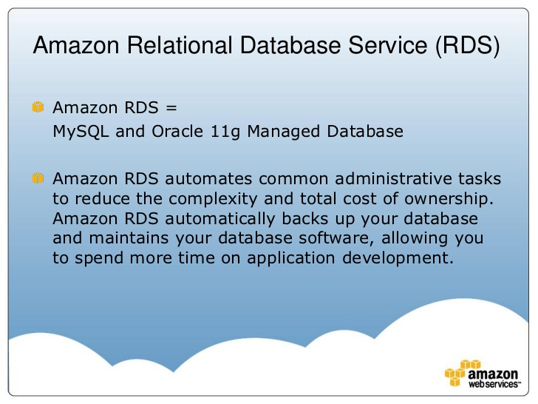
Amazon Relational Database

Slide 63
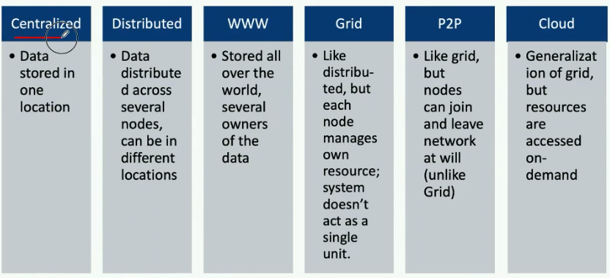
Different Database Architectures
Properties of Different DBS Architectures

Slide 64
Question 1
Discuss the advantages and disadvantages of different database architectures for different application scenarios.

Slide 65
Answers in Short
A. Centralised – suitable for simple applications, easy to manage; may not scale well
B. Distributed – Scalable, suitable for large applications and applications that need data access from different physical locations; System administration and crash recovery is difficult, usually have some data inconsistency
C. WWW – Very convenient to access and share data; security issues, no guarantee on availability or consistency
D. Grid – Less used now-a-days, very similar to distributed systems with administration done locally by each owner
E. P2P- Suitable when the nodes of the network cannot be planned in advance, or some may leave and join frequently. For example, sensor network
F. Cloud database – on-demand resources, cost-effective, maintenance done externally by the cloud provider; some privacy and confidentially issue – but most trusted providers well-address them

Slide 66
Question 3-I (Breakout Rooms)
Consider the different scenarios below and discuss which database architecture is the most suitable choice and why
– I. FriendBook is a new startup app that will launch its operation soon. They have only one office with not much budget right now, but they are expecting a high growth in the scale of millions of users across the globe in a couple of years. Which of the following database architecture is the most suitable choice for this scenario?
  a. Cloud storage
  b. World wide web
  c. Distributed database
  d. Centralised database
Notes:
Answer is a.
As FriendBook do not know a certain number of users and the exact timeline on the growth, the on-demand cloud storage is more cost-effective, can scale with the growth, can server clients across the globe, and Friendbook can focus more on developing their product instead of managing hardware resources.

Slide 67
Question 3-I (Answer)
Answer is a.
As FriendBook do not know a certain number of users and the exact timeline on the growth, the on-demand cloud storage is more cost-effective, can scale with the growth, can server clients across the globe, and Friendbook can focus more on developing their product instead of managing hardware resources.

Slide 68
Question 3-II.
FriendBook is a new social network site that will launch its operation soon. They have offices in many major cities of USA. They need a database that can handle millions of users across the globe. For preserving privacy and security, they need their own data storage system, which is not shared or owned by any other company. Which of the following database architecture is the most suitable choice for this scenario?
  a. Cloud storage
  b. World wide web
  c. Distributed database
  d. Centralised database
Notes:
Answer is c.
Unlike the previous scenario, if data is transferred and stored in a 3rd party storage like cloud, the security is not in the hands of FriendBook (including encryption guarantee, data discloser agreement, etc.). Hence, having the setup of their own distributed database (as they are located across many cities with many users across globe) is a more suitable solution.

Slide 69
Question 3-II (Answer).
Answer is c.
Unlike the previous scenario, if data is transferred and stored in a 3rd party storage like cloud, the security is not in the hands of FriendBook (including encryption guarantee, data discloser agreement, etc.). Hence, having the setup of their own distributed database (as they are located across many cities with many users across globe) is a more suitable solution.

